Slide 1






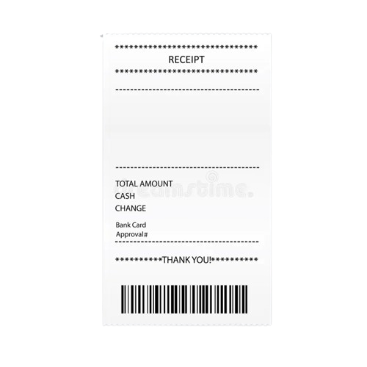

PATTY PATOOTIE
WELCOME TO
STUDENT SAVIOUR
PATTY
PATOOTIE
BURGER ORDERING SYSTEM

Slide 2

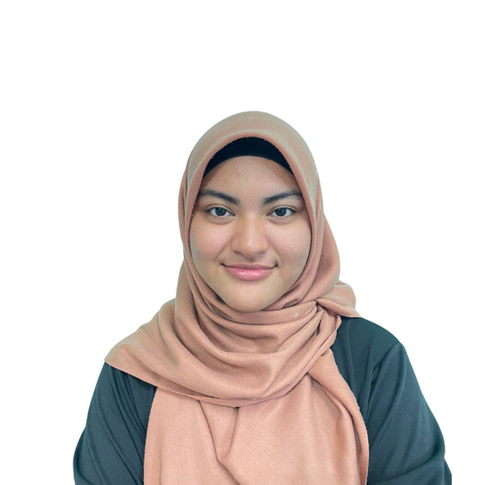
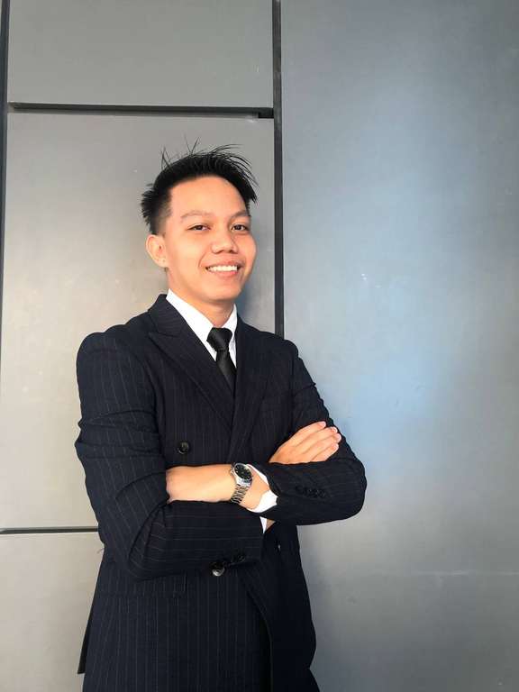
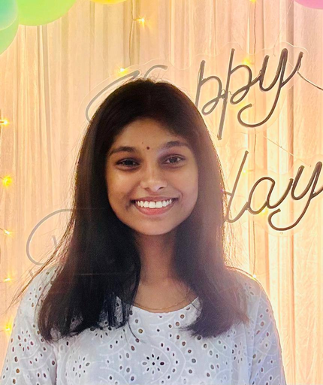
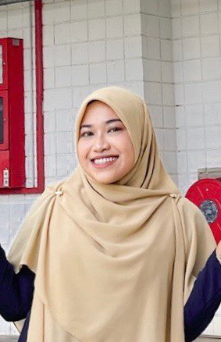
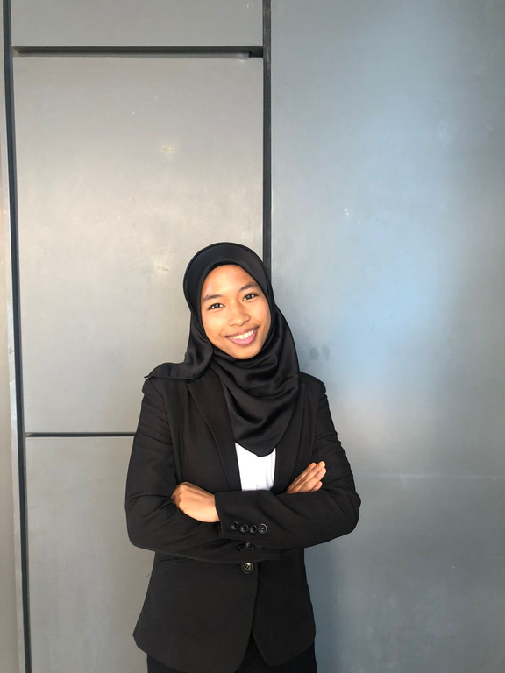
Nadzira Binti Ramli
Sheldon Stephen
Tharsinaa A/P Gunalan
22010431
22008944
22010151
Group
Members
Nur Aisyah Aida Binti Jaafar
Nurul Fatihah Binti Rizwan
22010178
22010182

Slide 3


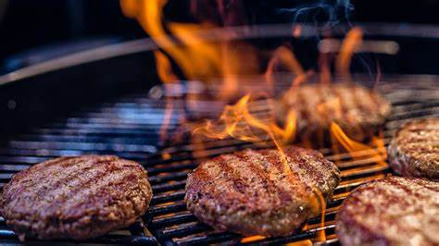
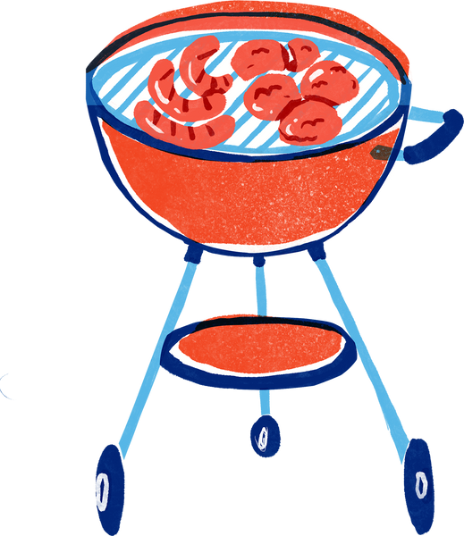
PROJECT
Idea
Current burger ordering systems frustrate customers due to their slow and complicated processes, causing delays in dining experiences. Customers find it hard to quickly customize and order meals, which lowers satisfaction with dining convenience.
To solve this, we propose a straightforward online burger ordering platform for customers. This platform simplifies the process from choosing burger options to placing orders, making it faster and user-friendly. With customizable orders and clear order updates, our solution aims to enhance customers' dining experiences with faster service and better convenience.

Slide 4
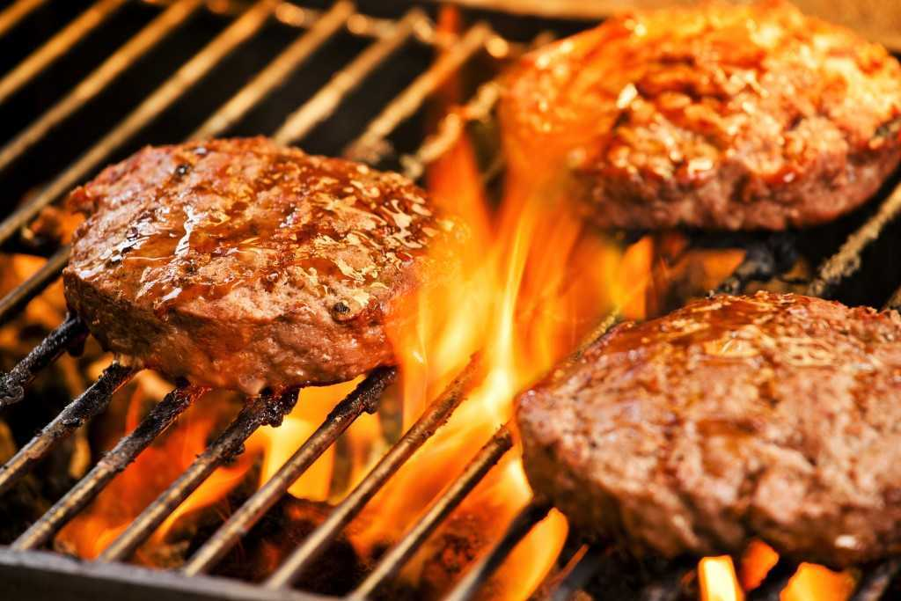

Introduction and Background
Problem:
Long queues and lack of customization at existing campus dining facilities lead to frustration and time wastage.
University Environment:
Students face time pressures between classes, activities, and study sessions.
Dining Needs:
Quick, easy, and personalized dining options are essential due to limited time.
Solution:
An online burger ordering system to streamline the dining experience for students.

Slide 5
Description of the Project
Project Overview: User-friendly system for efficient customer service
Customer Interaction:
Welcoming message
Unique order number generation
Order Finalization:
Total cost calculation with 6% service tax
Receipt printing with order details, total amount, date, and time stamp
Order Type Selection:
Dine-in or takeaway (+RM1.50 for takeaway)
Menu Options:
Key Features
Set Meals:
Set A: RM13.00 / RM7.00
Set B: RM15.00 / RM10.00
Set C: RM14.00 / RM9.00
Set D: RM12.50 / RM6.00
Set E: RM10.00 / RM5.00
Set F: RM13.00 / RM7.00
Set G: RM7.50 / RM3.50
Extras:
Nuggets (6 pcs) - RM8.00
Wedges - RM7.00
Ice Cream - RM3.00

Slide 6
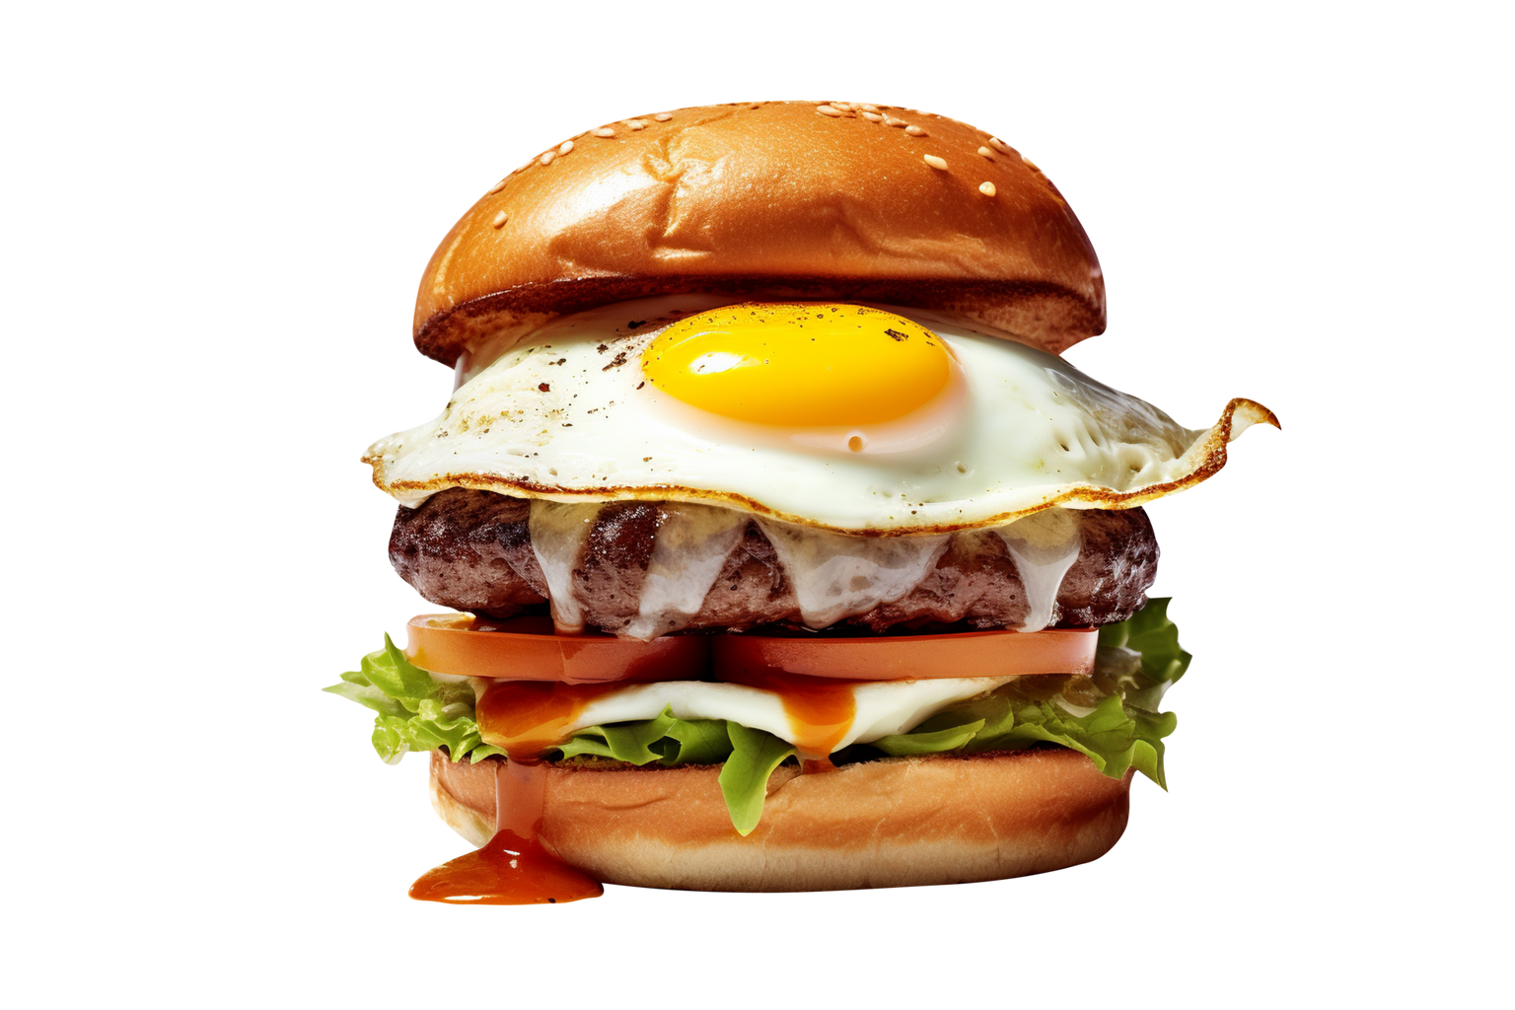
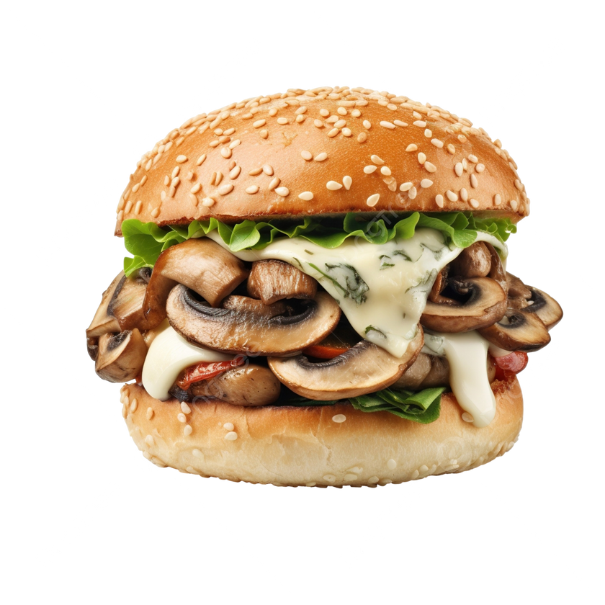
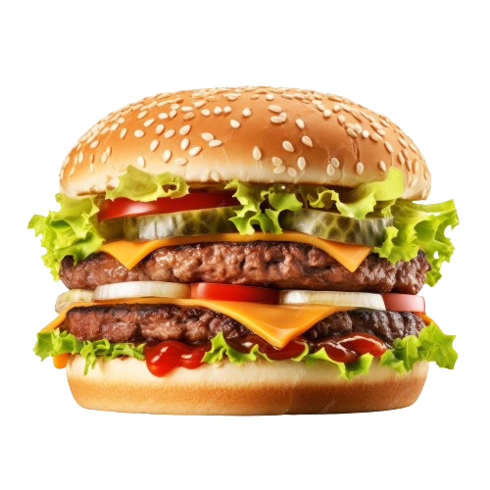
PATTY PATOOTIE
SOURCE CODE
STUDENT SAVIOUR
https://onlinegdb.com/iUhxKAorC

Slide 7

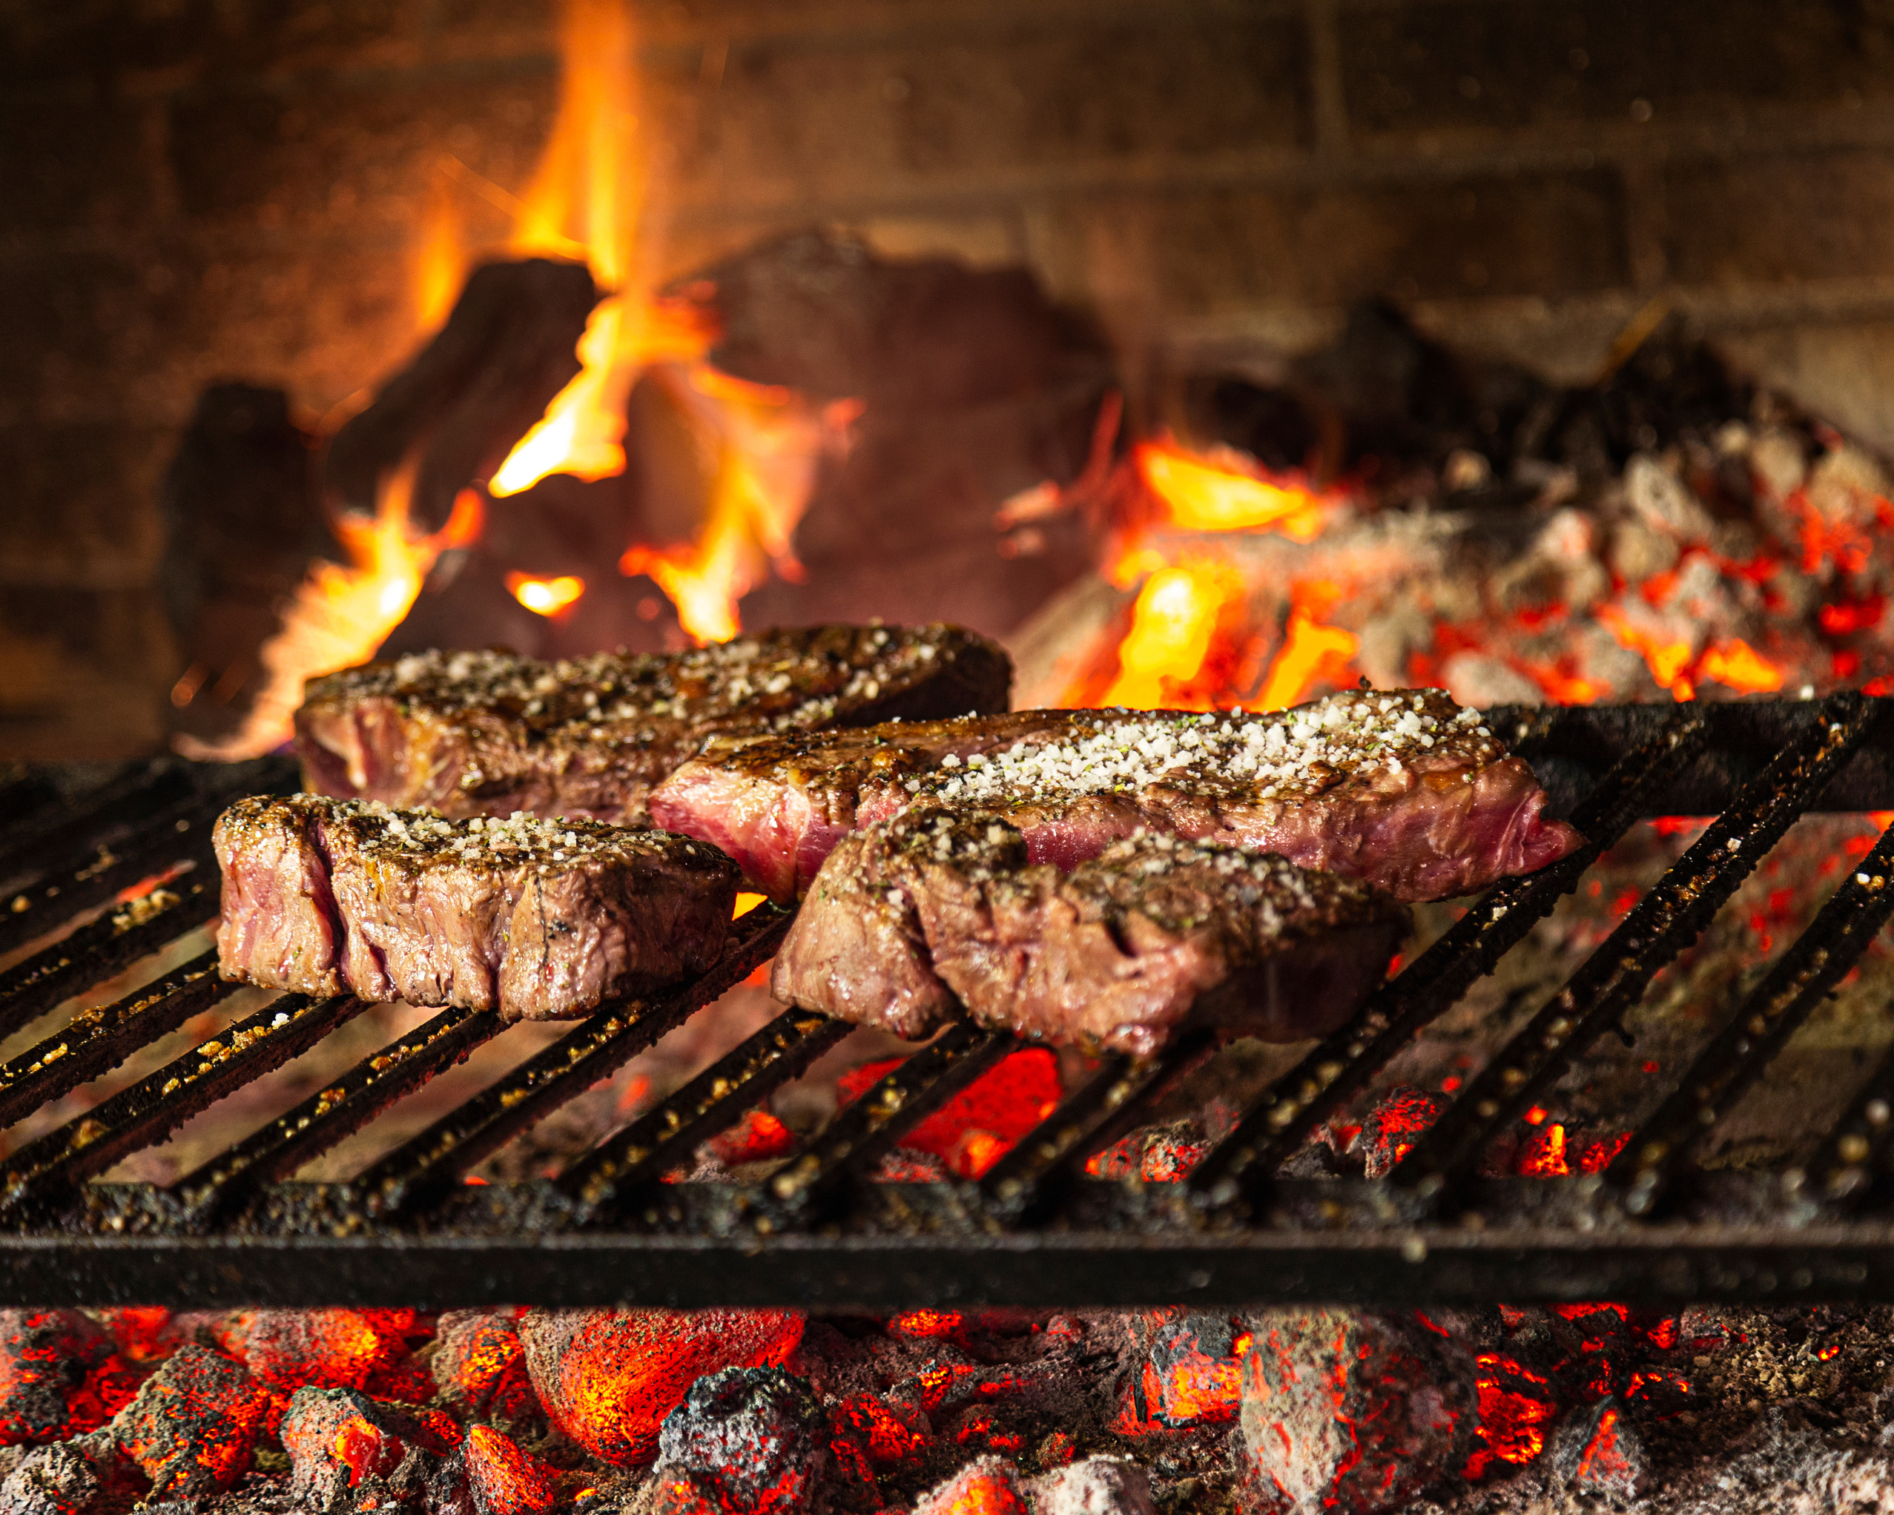
OUTPUTS

Slide 8
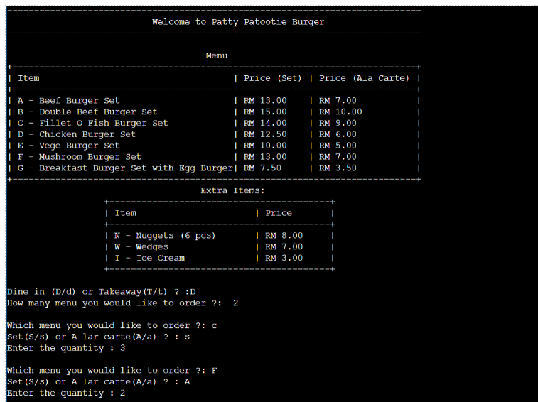
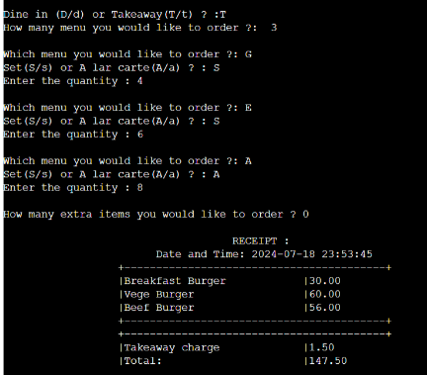
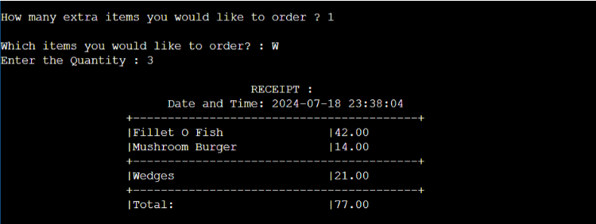
1
2

Slide 9


Patty Patootie
Thank You

